Slide 1
AY2021 Vietnam Internship Alternative Program
SGU (Promotion Office for Super Global University)
Yuji Mitsunaga

Slide 2
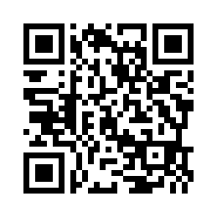
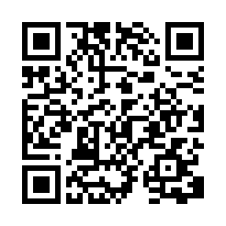
Vietnam Internship Alternative Program
Collaboration program with FPT University which is a partner university in Vietnam
4 weeks program in English
1 week Basic business program with FPT University
3 weeks Online internship with Vietnamese company
Application materials is here
Japanese https://www.u-aizu.ac.jp/sgu/info/news/5252021.html
English https://www.u-aizu.ac.jp/sgu/en/info/news/5252021.html

Slide 3
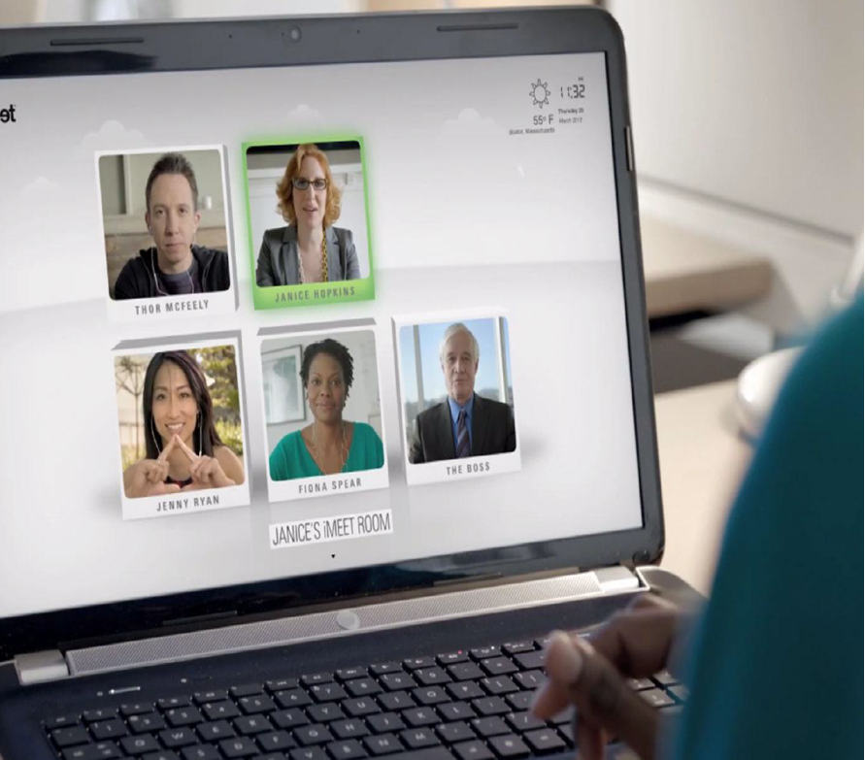
Motivation for participation in the program
Develop essential skills of remote working global trends
Enhance English communication skills
Learn basic remote work skills in corona disaster
Get Certificate of Internship Completion from FPT Education Global & Host company

Slide 4
Internship with Vietnamese Company
Training Period：From Mon. Aug. 23, 2021 To Fri. Sep. 17, 2021
Eligibility：1st-year undergraduate students – 2nd-year master students (Your programming or development skills are very helpful in the training)
Language：English
【Internship contents】
Software development
Advanced technology (IoT, AI, Big Data)
Application development
Business development
Marketing
Public relations

Slide 5
Vietnam Alternative Program Schedule
Briefing Session： Now (Zoom)
Application Periods： Wed. May, 12 ～ Tue. May, 25 Noon
Notify result of document screening：Tue. Jun, 1 (Planed)
Interview selection： Wed. Jun, 9 (Planed)
Notify final result ： Wed. Jun, 16
Transfer period 50 US dollar（deposit）：Jun,23～Jul, 5
400 US dollar：Jun, 23 ～ Aug, 9
Program period：Mon. Aug, 23 ～ Fri. Sep, 17
Submission report period：Mon. Sep, 20 ～ Fri Sep, 24 by mail

Slide 6
Vietnam Internship Alternative Program
【Note】
We will notify you of your acceptance of the grant or not as well.
A participant have to transfer all tuition fee in advance
Full payment (450 US dollar) or
initially transfer 50 US dollar as deposit, and transfer remained 400 US dollar by two weeks before starting.
Each grant recipient will be paid on the condition that he/she complete the program and submit a certificate of completion.
Participants will use a payment system “Paypal” to transfer tuition fee to FPT University.
Please resister as a member in advance.
(You can also transfer tuition fee via domestic bank, however the transfer expense is very expensive.)
If you use Paypal, you need to prepare a credit card or VISA debit card or VISA bundle card.
Please contact us if you do not have credit card.
Capacity
About six students
Tuition fee
450 US dollar（about 49,000 yen）※ Transfer fee is to be borne by successful student
Grant
Maximum about 35,000 yen/each for 6 students (Planed)
（Donated by Komatsuzaki Co., Ltd. and Local Venture Creation and Support Foundation)

Slide 7
Prepare application materials
【Submission materials】
Application form（for Vietnam alternative program only）
CV（Start describing as soon as possible）
Internship Participation Confirmation Form
Transcript（If you are not able to submit it because of university close etc., you do not have to submit it.）
【Notice】
☆You can submit them by email sgu-adm@u-aizu.ac.jp
☆Regarding supervisor’s sign in your Internship Participation Confirmation Document, you can ask your supervisor for permission of participation in the program by e-mail and submit it as a PDF file or by the forwarding mail.

Slide 8
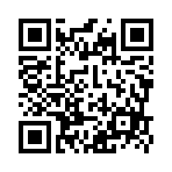
Questionnaire for the Briefing Session
Please access and answer an questionnaire of UoA overseas internship program.
https://forms.gle/1cQ33vCKyP6THSJY6
Application materials is here: www.u-aizu.ac.jp/sgu/
Japanese https://www.u-aizu.ac.jp/sgu/info/news/5252021.html
English https://www.u-aizu.ac.jp/sgu/en/info/news/5252021.html
If you have any questions, please send email
sgu-adm@u-aizu.ac.jp

