Slide 1
AY2021 Silicon Valley Internship Alternative Program
SGU (Promotion Office for Super Global University)
Yuji Mitsunaga

Slide 2
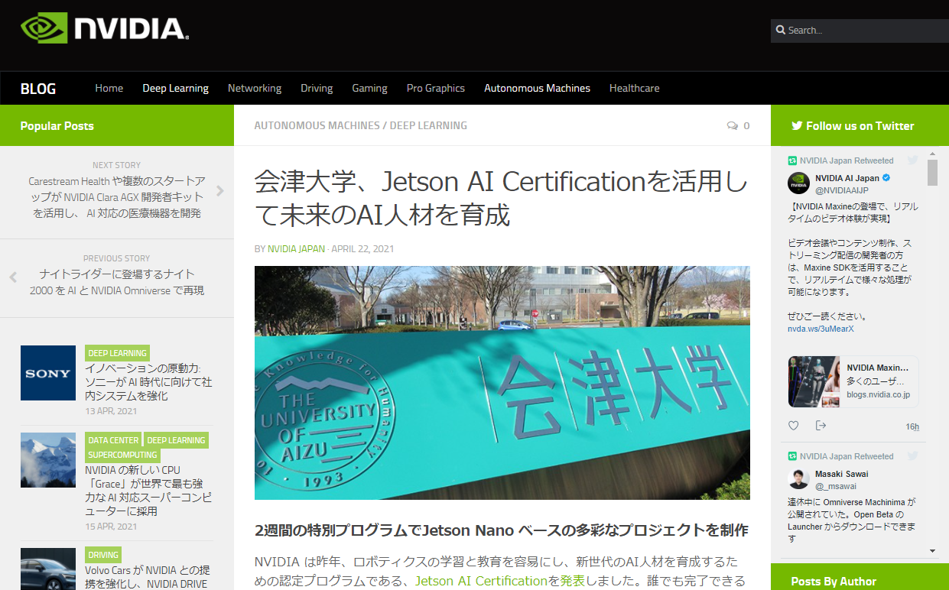
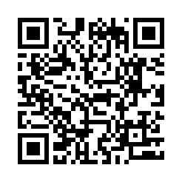
Silicon Valley Alternative Program
Training Period：From Tue. Aug. 24, 2021 To Fri. Sep. 17, 2021
Eligibility：1st-year undergraduate students – 2nd-year master students (Your programming or development skills are very helpful in the training)
Language：English
The first half（two weeks）on-site lecture at UoA, however due to corona situation, lectures will be provided by online.
Develop a system using NVIDIA Jetson Nano （FaBo）
Take an exam related to Jetson AI Certification
Give a presentation to NVIDIA engineers lived in US.
Last academic year’s activities have been posted on NVIDIA’s website!

Slide 3
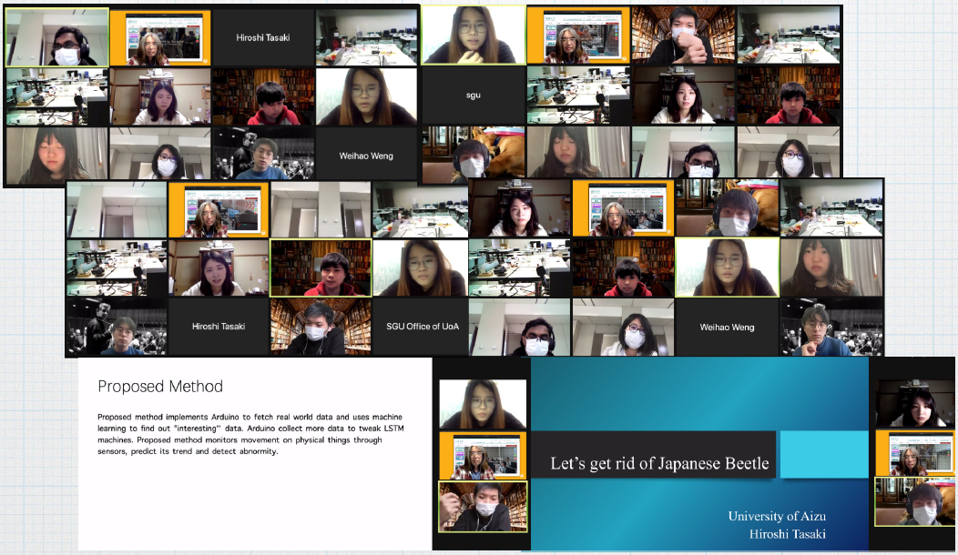
Second half（Two weeks） Silicon Valley Alternative Program
The training will be provided by online that will be connected from UoA, however
due to corona situation, lectures will be provided to connected from your home.
Students will develop products related to Arduino nano and discuss technology with Silicon Valley engineers.
On the last day, will present our result to engineers in Silicon Valley and students from local universities (San Jose State University, UCLA, UC Berkeley etc.) and discuss them.
現地名門大学生との討論

Slide 4
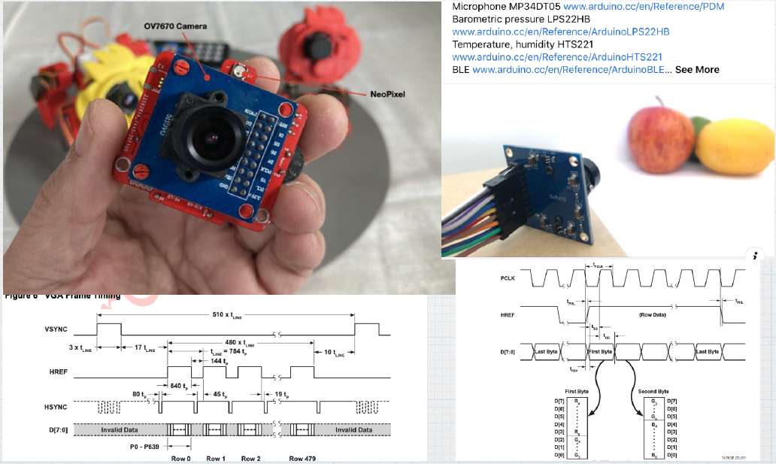
Silicon Valley Alternative Program
Startups CEOs introduce their own business
and discuss the services.
Final presentation

Slide 5
Silicon Valley Internship Schedule
Briefing Session： Now (Zoom)
Application Periods： Wed. May, 12 ～ Tue. May, 25 Noon
Notify result of document screening：Tue. Jun, 1 (Planed)
Interview selection： Wed. Jun, 9 (Planed)
Notify final result ： Wed. Jun, 16
Transfer period 50 US dollar（deposit）：Jun,23～Jul, 5
400 US dollar：Jun, 23 ～ Aug, 9
Program period：Tue. Aug, 24 ～ Fri. Sep, 17
Submission report period：Mon. Sep, 20 ～ Fri Sep, 24 by mail

Slide 6
Silicon Valley Internship Alternative Program
【Remarks】
Due to corona situation, it is possible to change provided by online only.
We especially welcome people who like to make things. Even if you are not, it will be a breakthrough for you to develop some technical skills.
You can also apply for the Vietnam program.
Capacity
About 11 students
Tuition fee
Free
※Please purchase your needed materials.
The program will implemented and supported by Local Venture Creation and Support Foundation.

Slide 7
Prepare application materials
【Submission materials】
Application form（for Silicon Valley Alternative Program）
Internship Participation Confirmation Form
Transcript（If you are not able to submit it because of university close etc., you do not have to submit it.）
【Notice】
☆You can submit them by email sgu-adm@u-aizu.ac.jp
☆Regarding supervisor’s sign in your Internship Participation Confirmation Document, you can ask your supervisor for permission of participation in the program by e-mail and submit it as a PDF file or by the forwarding mail.

Slide 8
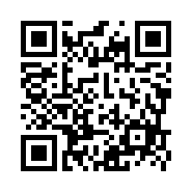
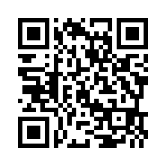
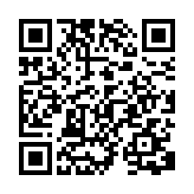
Questionnaire for the Briefing Session
Please access and answer an questionnaire of UoA overseas internship program.
https://forms.gle/1cQ33vCKyP6THSJY6
Application materials is here: www.u-aizu.ac.jp/sgu/
Japanese https://www.u-aizu.ac.jp/sgu/info/news/5252021.html
English https://www.u-aizu.ac.jp/sgu/en/info/news/5252021.html
If you have any questions, please send email
sgu-adm@u-aizu.ac.jp

